Slide 1
EE4007 - Optical Electronics
Lecture 6 - Optical fibre waveguides
© Alan P. Morrison
January 2010

Slide 2
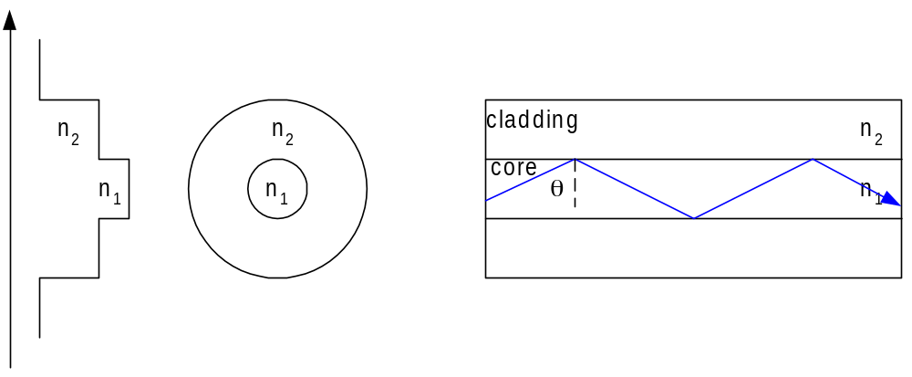
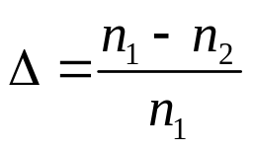
Step-index fibre
As with dielectric slab, complete guidance requires that the reflection angle, θ, be >= the critical angle θ_{c}
The fractional refractive index change Δ is an important fibre parameter, given by:
it is always +ve because n₁ must be > n₂ for critical angle to exist
Step-index (SI) fibre consists of a central core whose refractive index is n₁, surrounded by a cladding whose refractive index is n₂
© Alan P. Morrison
January 2010

Slide 3
Step-index fibre
Some of the light travels in the cladding as an evanescent wave
if the cladding in non-absorbent then this light is not lost but travels along the fibre
Evanescent fields decay rapidly, so no light will reach the edge of the cladding if it is a few tens of microns thick.
The cladding is important for protecting the core from contamination, ensuring its physical integrity
3 common forms of step-index fibre:
  glass core, clad with glass of lower refractive index
  silica glass core, clad with plastic (PCS)
  plastic core clad with another plastic (POF)
© Alan P. Morrison
January 2010

Slide 4
Step-index fibre
Smaller index steps for all glass fibres, largest index steps available with all plastic fibres
modal distortion and NA increase with refractive index difference
Fibres with little pulse spread have long rate-length products, but a small NA - making it difficult to efficiently couple light into them
Attenuation loss:
  all glass (~few dB/km)< PCS (~8 dB/km) < POF (~100’s dB/km)
Some conclusions regarding performance and application of the 3 types of SI fibres (all apply to multimode fibres)
  all-glass fibres have lowest losses and smallest pulse spread
© Alan P. Morrison
January 2010

Slide 5
Step-index fibre
  They are useful for moderately high information rates or fairly long lengths (30 MHz-km easily achievable)
  Their low NA results in large coupling losses, but low transmission losses partially compensates this
  typical SI fibre dimensions are: 50/125, 100/140, 200/230 where 50 is core diameter in microns, 125 is clad diameter
  PCS fibres have higher losses and larger pulse spreads than all-glass fibres => suitable for shorter links.
  Higher NA increases source coupling efficiency, bu ths advantage is lost in a long fibre due to increased absorption
  PCS normally suitable for links < few hundred metres
© Alan P. Morrison
January 2010

Slide 6
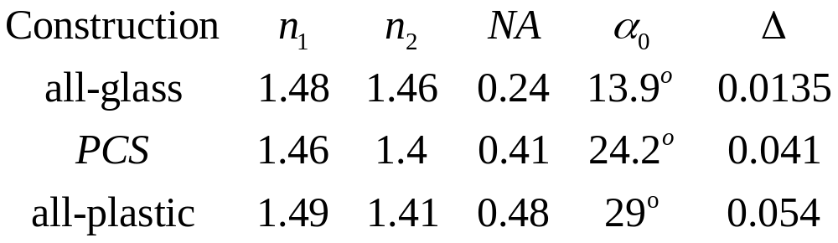
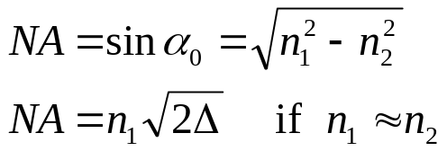
Step-index fibre
  Core diameters of 200μm are typical for PCS fibres
  larger core diameter improves source coupling efficiency
  POF limited to very short path lengths (10s of metres) due to high propagation losses
  Large cores (up to 1mm typical) and large NA make POF useful because of high coupling efficiency
Table compares properties of all-glass, PCS and POF
© Alan P. Morrison
January 2010

Slide 7
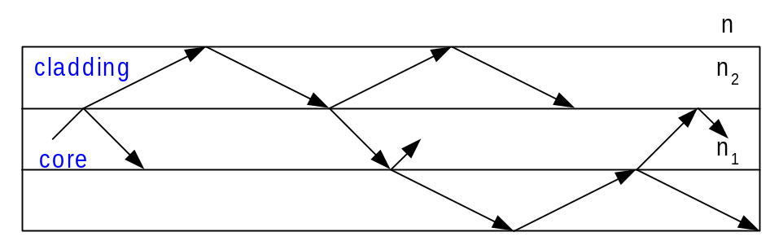
Step-index fibre
Larger NA advantageous because of larger acceptance angle and hence improved light collection
existence of cladding modes:
cladding modes excited by light entering the fibre at angles greater than the acceptance angle
light travelling in a cladding mode attenuates more rapidly than light in a core mode because the outer boundary of the cladding is normally in contact with a lossy material
small bends in the fibre also cause radiation losses
© Alan P. Morrison
January 2010

Slide 8
Step-index fibre
Power in cladding modes can be observed close to the light source, but is attenuated so rapidly that cladding modes are insignificant at end of a long fibre
Cladding modes are eliminated in some fibres by coating the cladding with a material having a refractive index >= that of cladding itself
In such a fibre, referred to as one with a matched buffer, a critical angle does not exist at the outer boundary of the cladding.
© Alan P. Morrison
January 2010

Slide 9
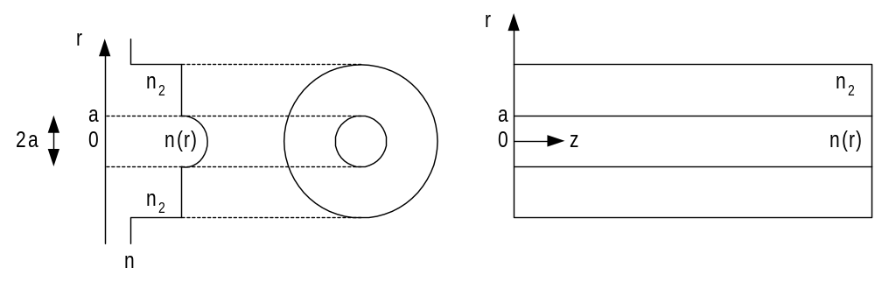
Graded-index fibre
Graded-index fibre (GRIN) has a core material whose refractive index decreases continuously with distance from the fibre axis
GRIN fibre guides light by trapping rays, similar to SI fibre
© Alan P. Morrison
January 2010

Slide 10
Graded-index fibre
Index variation is described by:
solving this for the scale factor, Δ yields:
n₁=refractive index along axis;
a=core radius; α=parameter describing profile variation
© Alan P. Morrison
January 2010

Slide 11
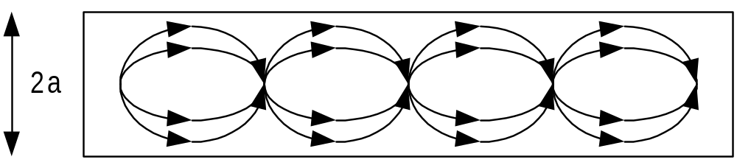
Graded-index fibre
Light rays travel through the fibre in an oscillatory fashion
the changing refractive index causes the rays to be continuously redirected towards the fibre axis
© Alan P. Morrison
January 2010

Slide 12
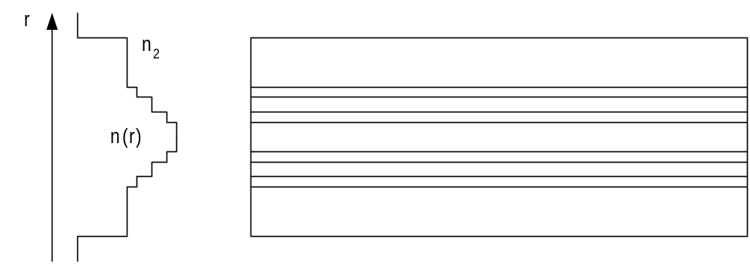
Graded-index fibre
can model continuous refractive index change as a series of small step changes
© Alan P. Morrison
January 2010

Slide 13
Graded-index fibre
Model can be made more accurate by increasing the number of steps
A ray crossing the fibre axis strikes a series of boundaries, each time travelling into a region of smaller refractive index, thus bending farther towards the horizontal axis
At one of the boundaries away from the axis, the ray angle exceeds the critical angle and is totally reflected back towards the fibre axis
now ray goes from low to higher refractive index media, thus bending towards the normal until it crosses the fibre axis, at which point the procedure repeats
© Alan P. Morrison
January 2010

Slide 14
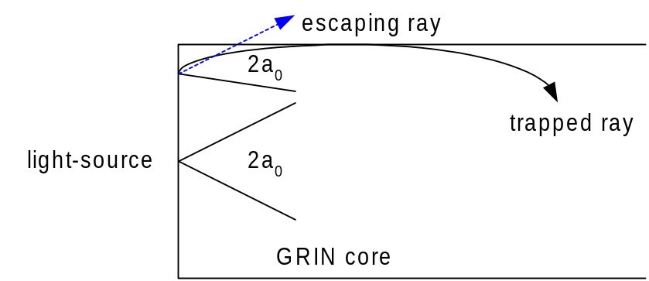
Graded-index fibre
Just like SI fibre, GRIN fibre has a NA and related acceptance angle
The acceptance angle and NA decrease with radial distance from the axis => coupling more efficient near axis
Different to SI fibre, whose NA remains same regardless of entry point => coupling efficiency generally higher for SI fibres
© Alan P. Morrison
January 2010

Slide 15
Graded-index fibre
Parabolic index profile - α = 2, core index:
for Δ << 1, variation is adequately described by:
Numerical aperture is:
Plot this function for n₁=1.48 and Δ=0.0135 => n₂=1.46, axial NA=0.24 => parabolic shape (exercise: plot NA versus (r/a))
NA drops off to zero at the edge of the core
© Alan P. Morrison
January 2010

Slide 16
Attenuation
Glass
  molecules of silica (SiO₂), mixture not crystal
  change refractive index by doping
    titanium, thallium, germanium, boron and other materials
    germanium increases refractive index of silica => use in core
  losses in glass fibres can be classified as
    absorption
    scattering
    geometric effects
Absorption
  intrinsic absorption - natural property of material
© Alan P. Morrison
January 2010

Slide 17
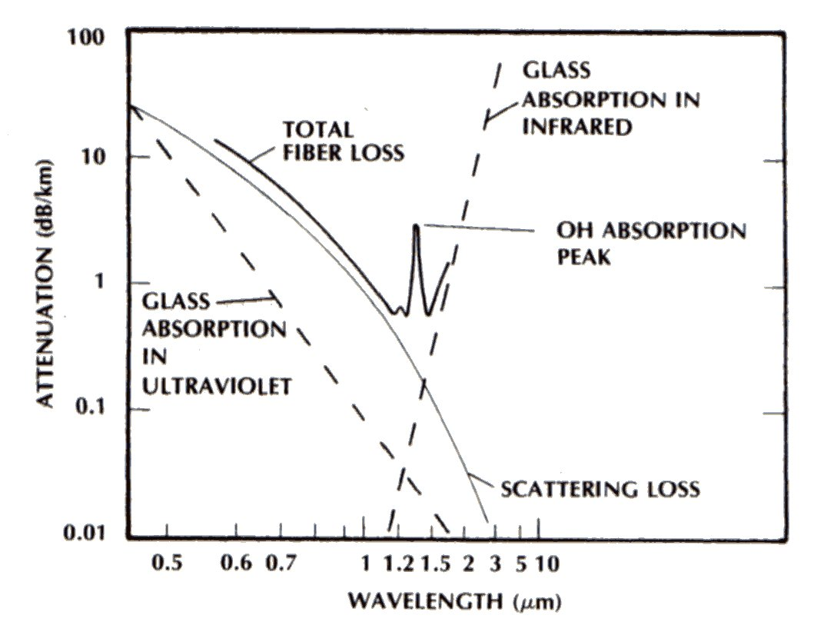
Attenuation – Ge doped Silica
© Alan P. Morrison
January 2010

Slide 18
Attenuation
  Strong absorption in short-wavelength U.V. region of spectrum
    due to strong electronic and molecular transition bands
    peak loss in U.V. diminishing as visible region approached
    not important for comms applications
  intrinsic absorption peaks also between 7 and 12 μm
    again not near region of interest
  Impurities are major source of loss in any fibre
    transition metal ions e.g. Fe, Cu, V, Co, Ni, Mn, Cr - must be kept to ppb levels
    OH ions - most significant at 1.37, 1.23 and 0.95 μm - must be kept to ppm levels
© Alan P. Morrison
January 2010

Slide 19
Attenuation
  Rayleigh scattering
    during manufacturing process, random molecular locations give random variations in refractive index within the glass
    can model these variations as small scattering centres, with sizes less than the optical wavelengths
    a beam of light passing through this structure will have some of its energy scattered by these scattering centres
  Inhomogeneities
    introduced in manufacturing
    scattering objects larger than optical wavelengths
    unlike Rayleigh scattering - independent of wavelength
    can be controlled with proper manufacturing techniques
© Alan P. Morrison
January 2010

Slide 20
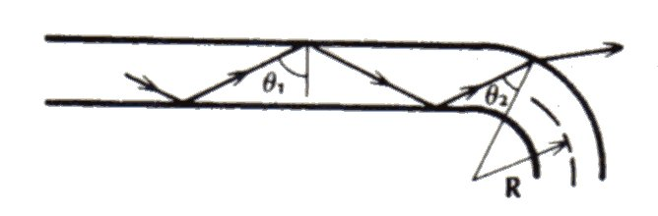
Attenuation
  Geometric effects
    bending a fibre causes attenuation
    macroscopic bending due to normal spooling or fibre manipulation
    loss negligible for bend radii ~ 25mm (for 125μm diameter fibres)
    bending also reduces a fibres tensile strength
    higher ordered modes are more susceptible to this loss
    microscopic bending occurs when fibre sheathed within a protective cable
    microbends couple light between the various guided modes and cause some light to couple out of the fibre
© Alan P. Morrison
January 2010

Slide 21
Attenuation
  Total attenuation
    all loss phenomena are combined to yield the total attenuation
    Fibre attenuation measured in several ways (i) cutback technique - used when both fibre ends are available (ii) OTDR - requires only one fibre end for measurement. Transmits optical pulse and measures reflections. Time delay of reflections is a measure of their location along fibre
© Alan P. Morrison
January 2010

Slide 22
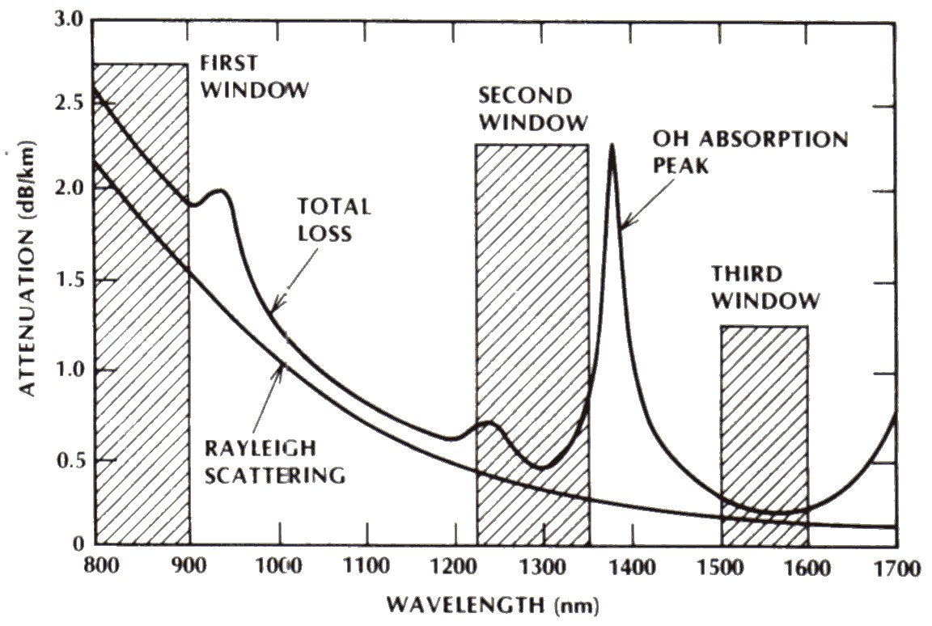
Attenuation – Silica glass
© Alan P. Morrison
January 2010

Slide 23
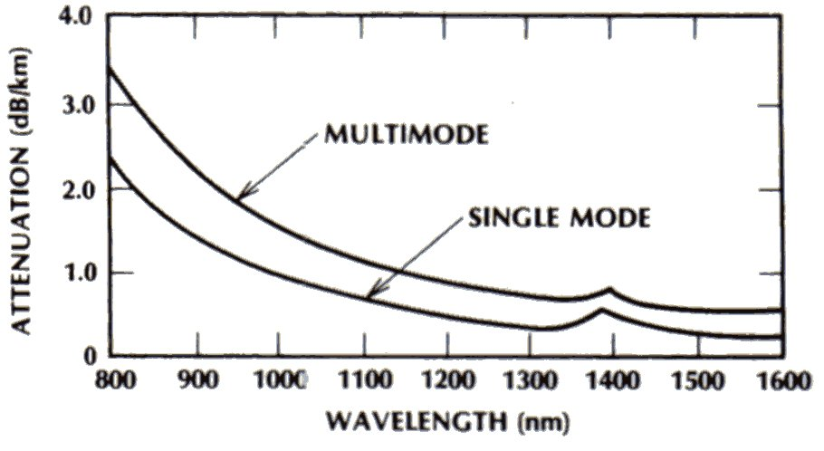
Spectral Attenuation – all-glass
© Alan P. Morrison
January 2010

Slide 24
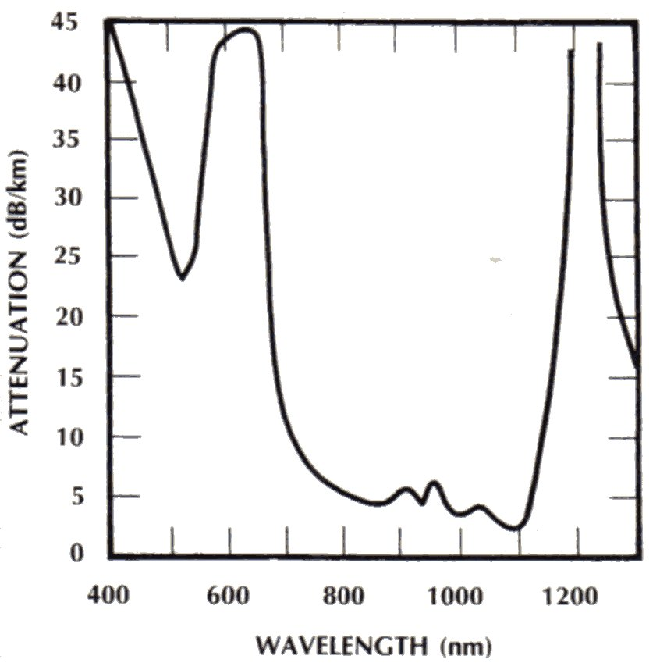
Attenuation – hard-clad silica
© Alan P. Morrison
January 2010

Slide 25
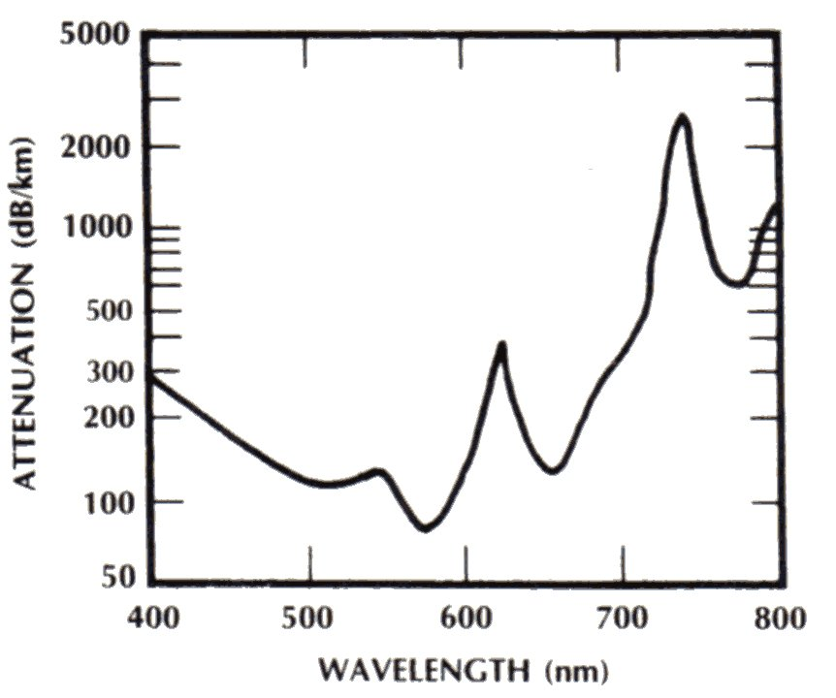
Attenuation – plastic fibre
© Alan P. Morrison
January 2010

Slide 26
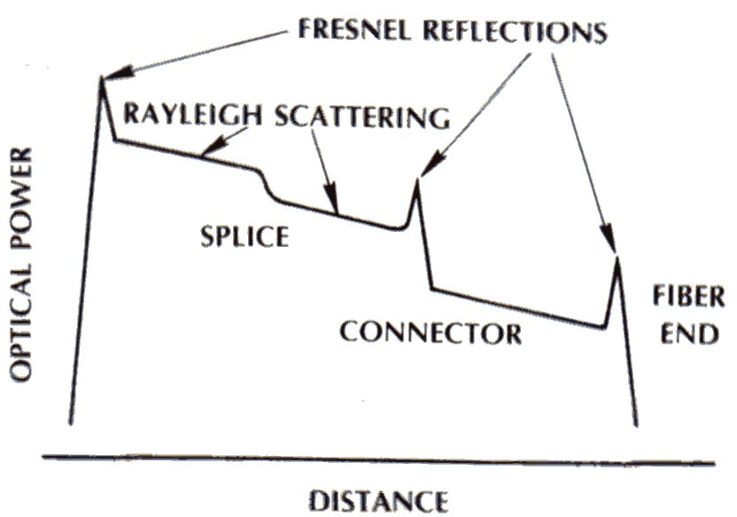
Optical time-domain reflectometry
© Alan P. Morrison
January 2010

